Slide 1
MODULO SMART HOME SYSTEM
MODULE 1,2,3
Presented By : Ann Martin (1317157)
Ankit Kumar (1317188)
Keerthana.T (1317191)
Department of Computer Science and Engineering
Guide : Bijeesh T V
2016-2017-March

Slide 2
Introduction First Module “DAD”
“DAD” – Door Alert System For Deaf People
How it Works?
    This module is wireless
    Two Devices will be implemented
    One for sensor
    Other for vibration
Sensor Device- Sense the object and data is stored in microcontroller after that data is transmitted to the receiver device using RF circuits
Receiver Device- Receiver device is small pocket size device which will receive transmitted data from sensor device

Slide 3
Connecting Device with Database
Using python to get sensor reading from transmitter with time and data visited by guests
Storing in database using python sqlite3 module
deploying data to cloud, so person can track who is visited to his/her home

Slide 4
Code
import serial #Import Serial Library
import datetime
from time import gmtime, strftime
#import database
import sqlite3
conn = sqlite3.connect('visitor.db')
c = conn.cursor()
c.execute('''CREATE TABLE IF NOT EXISTS stocks
(DateOfVisit text, TimeVisited text, Visitor text)''')
get_date = strftime("%a, %d %b %Y ", gmtime())
get_time = strftime("%H:%M:%S", gmtime())
arduinoSerialData = serial.Serial('com4',9600)
database = []
while (1==1):
if (arduinoSerialData.inWaiting() > 0):
myData = arduinoSerialData.readline()
print myData
c.execute("INSERT INTO stocks (DateOfVisit, TimeVisited, Visitor ) VALUES (?,?,?)",(get_date,get_time,myData))
conn.commit()
conn.close()

Slide 5
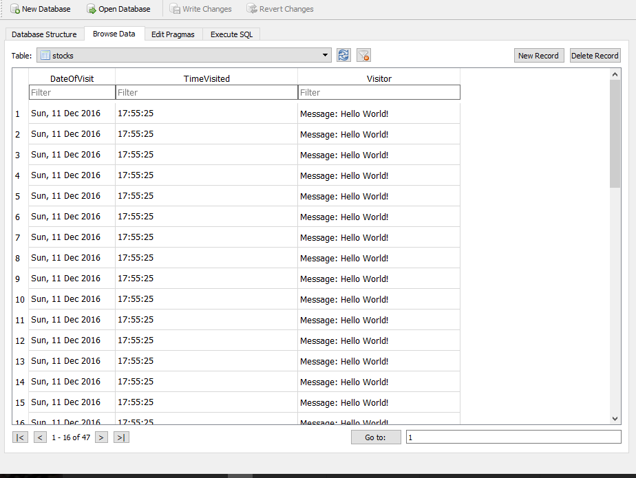
Sample data

Slide 6
Second Module- Pulse sensor
Pulse sensor is an plug and play heart rate sensor for arduino. It can be used by students artists athletes who want to easily incorporate live heart rate data. The sensor clips onto a fingertip or earlobe and plugs right into Arduino.
A pulse sensor is a personal monitoring device which allows one to measure his or her heart rate in real time.
Widely used in hospitals for checking the health of patients.

Slide 7
Applications
Better and accurate method of measuring heart beat.
Hospitals/Dispensaries
At homes
Have become a widely used training aid for a variety of sports.
A set point can help in determining whether a person is healthy or not checking his/her heart beat and comparing with set point.

Slide 8
Home Automation
Using cloud service person can easily access home appliances such light, fan and door.
Person can also trigger light fan or other appliances with according to time.
Android app that will work as remote control.

Slide 9
Code for Connecting to cloud - rpi_fxq776b3ch.sh
#!/bin/bash
# myDevices setup script
set -e
NAME="$0"
PREFIX="myDevices-1.0"
HOME="$( cd "$( dirname "${BASH_SOURCE[0]}" )" && pwd )"
echo $NAME
codeRaw="${NAME##*_}"
inviteCode="${codeRaw%.*}"
if [ -d "/etc/myDevices" ]; then
echo "dir exists"
if ! grep -q InviteCode /etc/myDevices/AppSettings.ini ; then
echo "Invite code does not exist but directory does so we will add invite code"
sed -e "/Agent/ a InviteCode = $inviteCode" </etc/myDevices/AppSettings.ini>/etc/myDevices/NewAppSettings.ini && mv /etc/myDevices/NewAppSettings.ini /etc/myDevices/AppSettings.ini
sed "s/Initialized = .*/Initialized = false/g" </etc/myDevices/AppSettings.ini>/etc/myDevices/NewAppSettings.ini && mv /etc/myDevices/NewAppSettings.ini /etc/myDevices/AppSettings.ini
sed '/Id = /d' </etc/myDevices/AppSettings.ini>/etc/myDevices/NewAppSettings.ini && mv /etc/myDevices/NewAppSettings.ini /etc/myDevices/AppSettings.ini
sudo service myDevices stop
sudo service myDevices start
exit;
fi
fi
echo "continuing as new install..."
wget -O $HOME/$PREFIX.tar.gz "http://updates.mydevices.com/raspberry/myDevices-1.0.tar.gz"
tar -xzvf $HOME/$PREFIX.tar.gz
cd $HOME/$PREFIX
chmod +x $HOME/$PREFIX/setup.sh
bash -x $HOME/$PREFIX/setup.sh -code "$inviteCode" "$@"

Slide 10
Command to connect Cloud with device
        sudo bash rpi_fxq776b3ch.sh -v

Slide 11
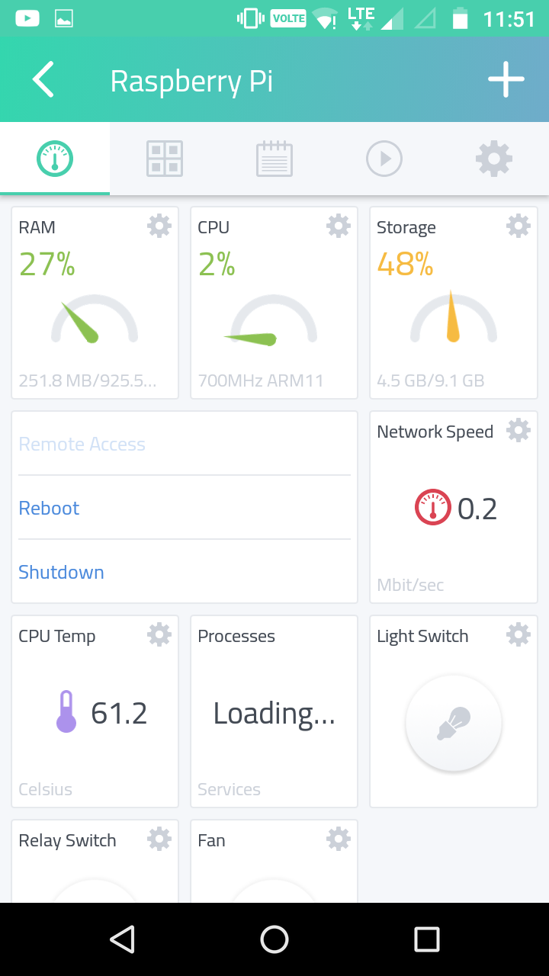
Android App Dashboard

Slide 12
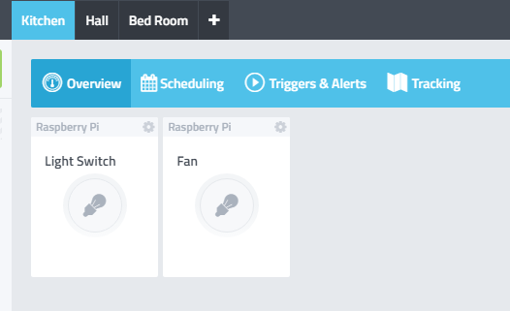
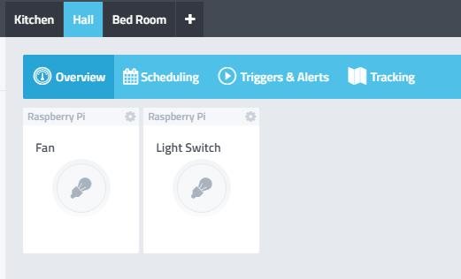
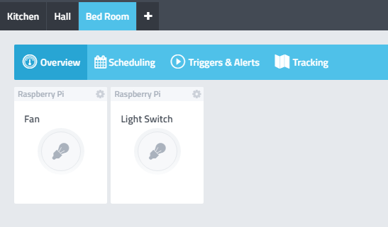
Interface- Kitchen, Hall, Bedroom
Interface For Kitchen Switch Control Interface For Hall Switch Control
Interface For Bedroom Switch Control

Slide 13
Experimental Result
The second module – using pulse sensor
Board used: Arduino/ Arduino Uno
The transmitter sends signal to the receiver, and the message is displayed in the computer screen
Adding code to the arduino board for the pulse sensor.
Adding the LED to display the progress and working of pulse sensor.
Modification required: Code Bugs, circuit implementation with proper model.

Slide 14
Requirements
1. Arduino Compiler
2. Arduino Uno board
3. Arduino Nano board
4. RF module
5. Pulse sensor
6. USB cable
7. PCB board
8. Light Emitting Diode

Slide 15
Conclusion
Assemble all component in proper model.

Slide 16
References
Youtube.com
Arduino official website
http://homeautomationserver.com/
http://randomnerdtutorials.com/nrf24l01-2-4ghz-rf-transceiver-module-with-arduino/
R. I. Damper, M. D. Evans - “A Multifunction Domestic Alert System for the Deaf-Blind”- IEEE Transactions on Rehabilitation Engineering, Volume: 3, Issue: 4, Dec 1995 .
K. Vidyasagar, G. Balaji, K. Narendra Reddy- “Android Phone Enabled Home Automation”- Journal of Academia and Industrial Research (JAIR), Volume 4, Issue 2, July 2015.
Bilal Ghazal, Khalid Al-Khatib-“Smart Home Automation System for Elderly, and Handicapped People using Xbee” - International Journal of Smart Home, Vol. 9, No. 4 (2015).

Slide 17
References
Steve Warren, Jianchu Yao,, G. Edward Barnes – Wearable Sensors and Component Based Design for Home Health Care - IEEE 2002.
Alexandros Pantelopoulos and Nikolaos G. Bourbakis – A Survey on Wearable Sensor Based Systems for Health Monitoring and Prognosis-IEEE Transactions on Systems- Vol. 40, No. 1, Jan. 2010.
Adrian Burns, Barry R. Greene, Michael J. McGrath* - SHIMMER - A Wireless Sensor Platform for Noninvasive Biomedical Research- IEEE Sensors Journal, Vol. 10, No. 9, September 2010.
http://electronicdesign.com/digital-ics/build-wrist-heart-rate-monitor-using-ultra-low-power-mcu
https://www.tindie.com/products/rajbex/easy-pulse-sensor-based-on-photoplethysmography/
* There are 8 authors to this paper

Slide 18
        Trailer

